Slide 1
Betting Edge
Data-Driven Fantasy Football Predictions

Slide 2
Non-Technical Overview
Subject
Fantasy sports and sports betting are growing industries where users make decisions based on past player performance to win in fantasy leagues or place strategic bets
Problem Statement
By developing predictive models for fantasy points, I can help provide users with data-driven insights that help them make better choices, potentially increasing their success in fantasy leagues and betting outcomes
Opportunity
Fantasy sports players and bettors often struggle to predict player performance accurately, leading to missed opportunities and poor decision-making
Goal
These models aim to improve player performance forecasts, enabling users to make more informed lineup and betting decisions, thus enhancing their overall experience and competitiveness

Slide 3
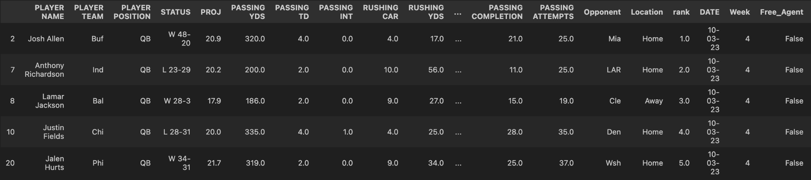
Proposed Vision using Data Science
Separate Models for Each Position:
Each position has distinct performance metrics and patterns (e.g., quarterbacks focus on passing yards, running backs on rushing yards), so individual models will be tailored to each position's unique characteristics
Building separate models allows us to capture the relevant statistics and features specific to each position, improving prediction accuracy for fantasy points
Position-Specific Feature Engineering:
Quarterbacks: Include features like passing yards, passing touchdowns, interceptions, and completion rates. These metrics heavily influence quarterback performance and fantasy points.
Running Backs: Focus on rushing yards, rushing touchdowns, rushing attempts, and receiving stats, as running backs often contribute to both rushing and receiving.
Wide Receivers and Tight Ends: Emphasize receiving metrics such as receptions, receiving yards, receiving touchdowns, and targets. These features drive fantasy points for these positions.
ML Models:
I will begin the process by building simple Linear Regression models for each player position as a benchmark for prediction accuracy
These baseline models will give insight into the relationships between features and help assess prediction accuracy for fantasy points
Throughout the course, I’ll explore more complex models (possibly like a Decision Tree Regression) that may handle non-linear relationships better

Slide 4
Estimated Impact
Enhanced Decision-Making
Users could improve lineup decisions and betting strategies, increasing their competitive edge in leagues and sports betting
Increased Engagement
Predictive insights could boost user engagement in fantasy sports platforms, as users rely on data-driven decisions
User Satisfaction/Revenue Growth
Improved decision-making could enhance user satisfaction, creating a loyal user base that values reliable, actionable insights
For sports betting platforms, accurate predictions can lead to an increase in betting activity, driven by user confidence in data-backed decisions

Slide 5
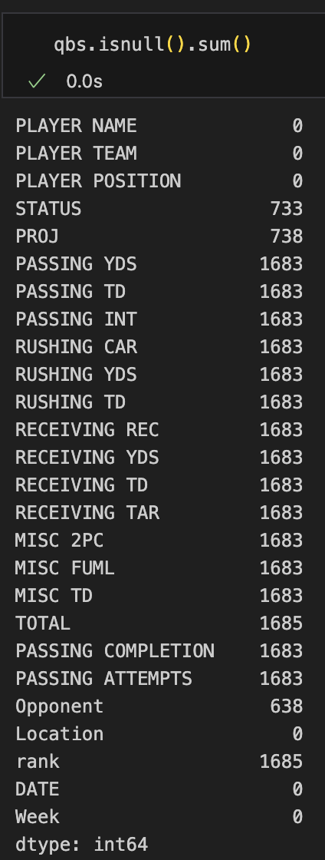
Dataset
Dataset Overview
18, 090 rows and 26 columns
The dataset comprises of weekly fantasy football data from the 2023 NFL Season across multiple sheets, each representing a different week in the NFL season. I consolidated these into a single dataframe for analysis
Each row contains various metrics on player performance, such as yards, touchdowns, and receptions, relevant to fantasy football scoring
Data Quality
The dataset was relatively clean upon initial inspection, though several columns contained significant null values that required attention
Preliminary EDA Findings
Quarterbacks: Total score is driven by passing yards and touchdowns
Running Backs: Strongly impacted by rushing stats; moderate boost from receiving
Tight Ends: Primarily influenced by receptions and receiving yards
Wide Receivers: Total score relies heavily on receptions and receiving yards; touchdowns moderately boost score

Slide 6
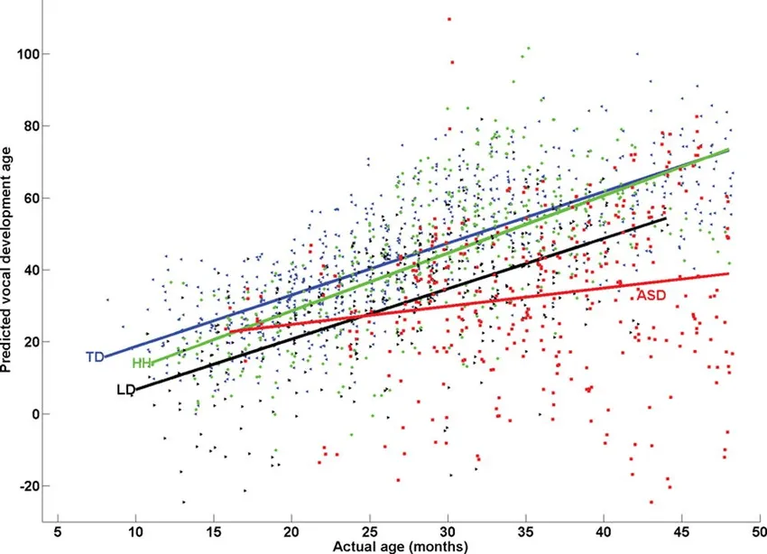
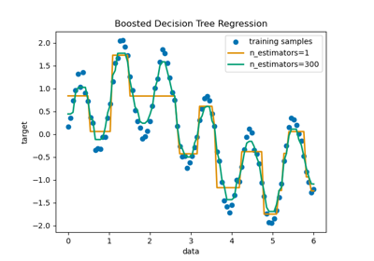
Next Steps
Baseline Modeling:
Start with Linear Regression via the scikit-learn library, assess model accuracy, and identify improvement areas.
Make a decision on which ML model to use as the final model (eg. Decision Tree)
EDA:
Dive deeper into performance metrics by position (QB, RB, WR, TE) to understand position-specific trends and variability.
Compare average performance metrics (e.g., average rushing yards for RBs) to see how each position contributes differently to fantasy points.
Visualize relationships between fantasy points and contextual factors, such as home vs. away games and winning vs. losing outcomes, to capture any game environment effects.
Consider time-series visualizations to track performance trends across the season.
More data:
Look into potentially incorporating more data in order to enhance model accuracy, capture additional player performance metrics, and account for external factors like weather conditions or team dynamics that could influence fantasy points

